Slide 1

Partnering with Explainable AI
Michael Winikoff
Te Herenga Waka - Victoria University of Wellington
New Zealand
Notes:
ABSTRACT: Contemporary Artificial Intelligence tools offer significant potential to support people in a range of tasks and roles. However, in order for this potential to be appropriately realised we need to better understand how humans and AI work together: the capabilities of modern AI tools mean that we need to shift from viewing the AI as a passive tool to viewing it as a partner. We examined this in the context of work-based analytics through an interpretive case study interviewing 28 workers. We found that while there were indeed opportunities for the AI tool to provide useful support, there were also a number of barriers: accuracy, transparency, feedback, and configurability, as well as misalignment of categories. We argue that explainability is a crucial feature, since it supports transparency, can help ensure accuracy (or at least detect inaccuracy), and plays a role in feedback. We also argue that in some domains there is a “right to explanation” that arises as a consequence of existing human rights legislation. We then consider how the explainability of a given system can be assessed, proposing a scoresheet for doing so. Finally, we report on an evaluation of the effectiveness of explanation, showing that the link between explanation and trust can be complex and sometimes counter-intuitive.
40 minutes + questions/discussion

Slide 2
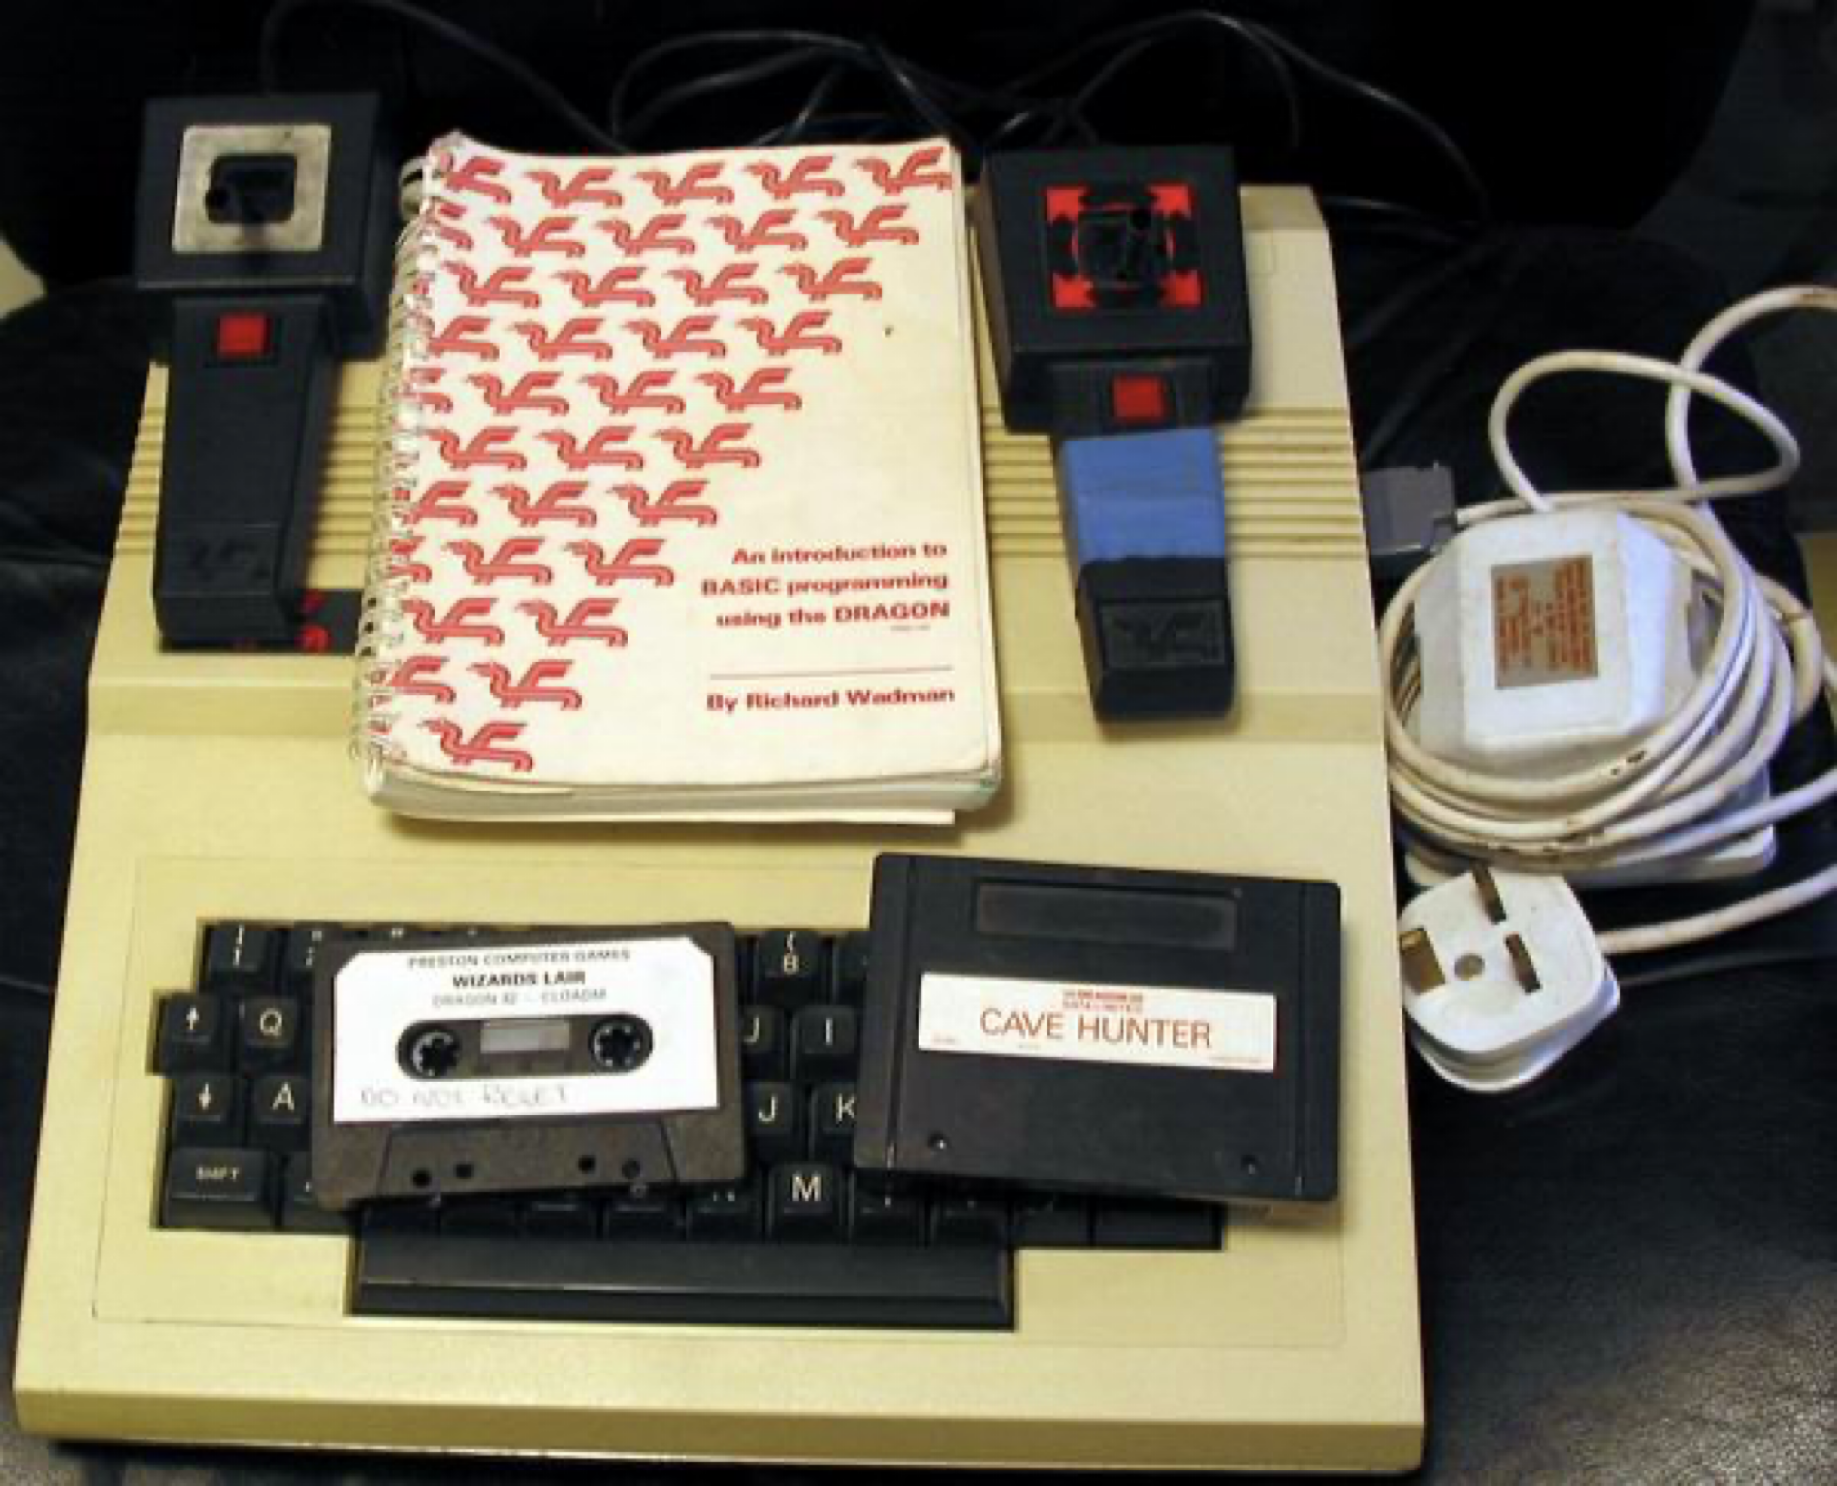
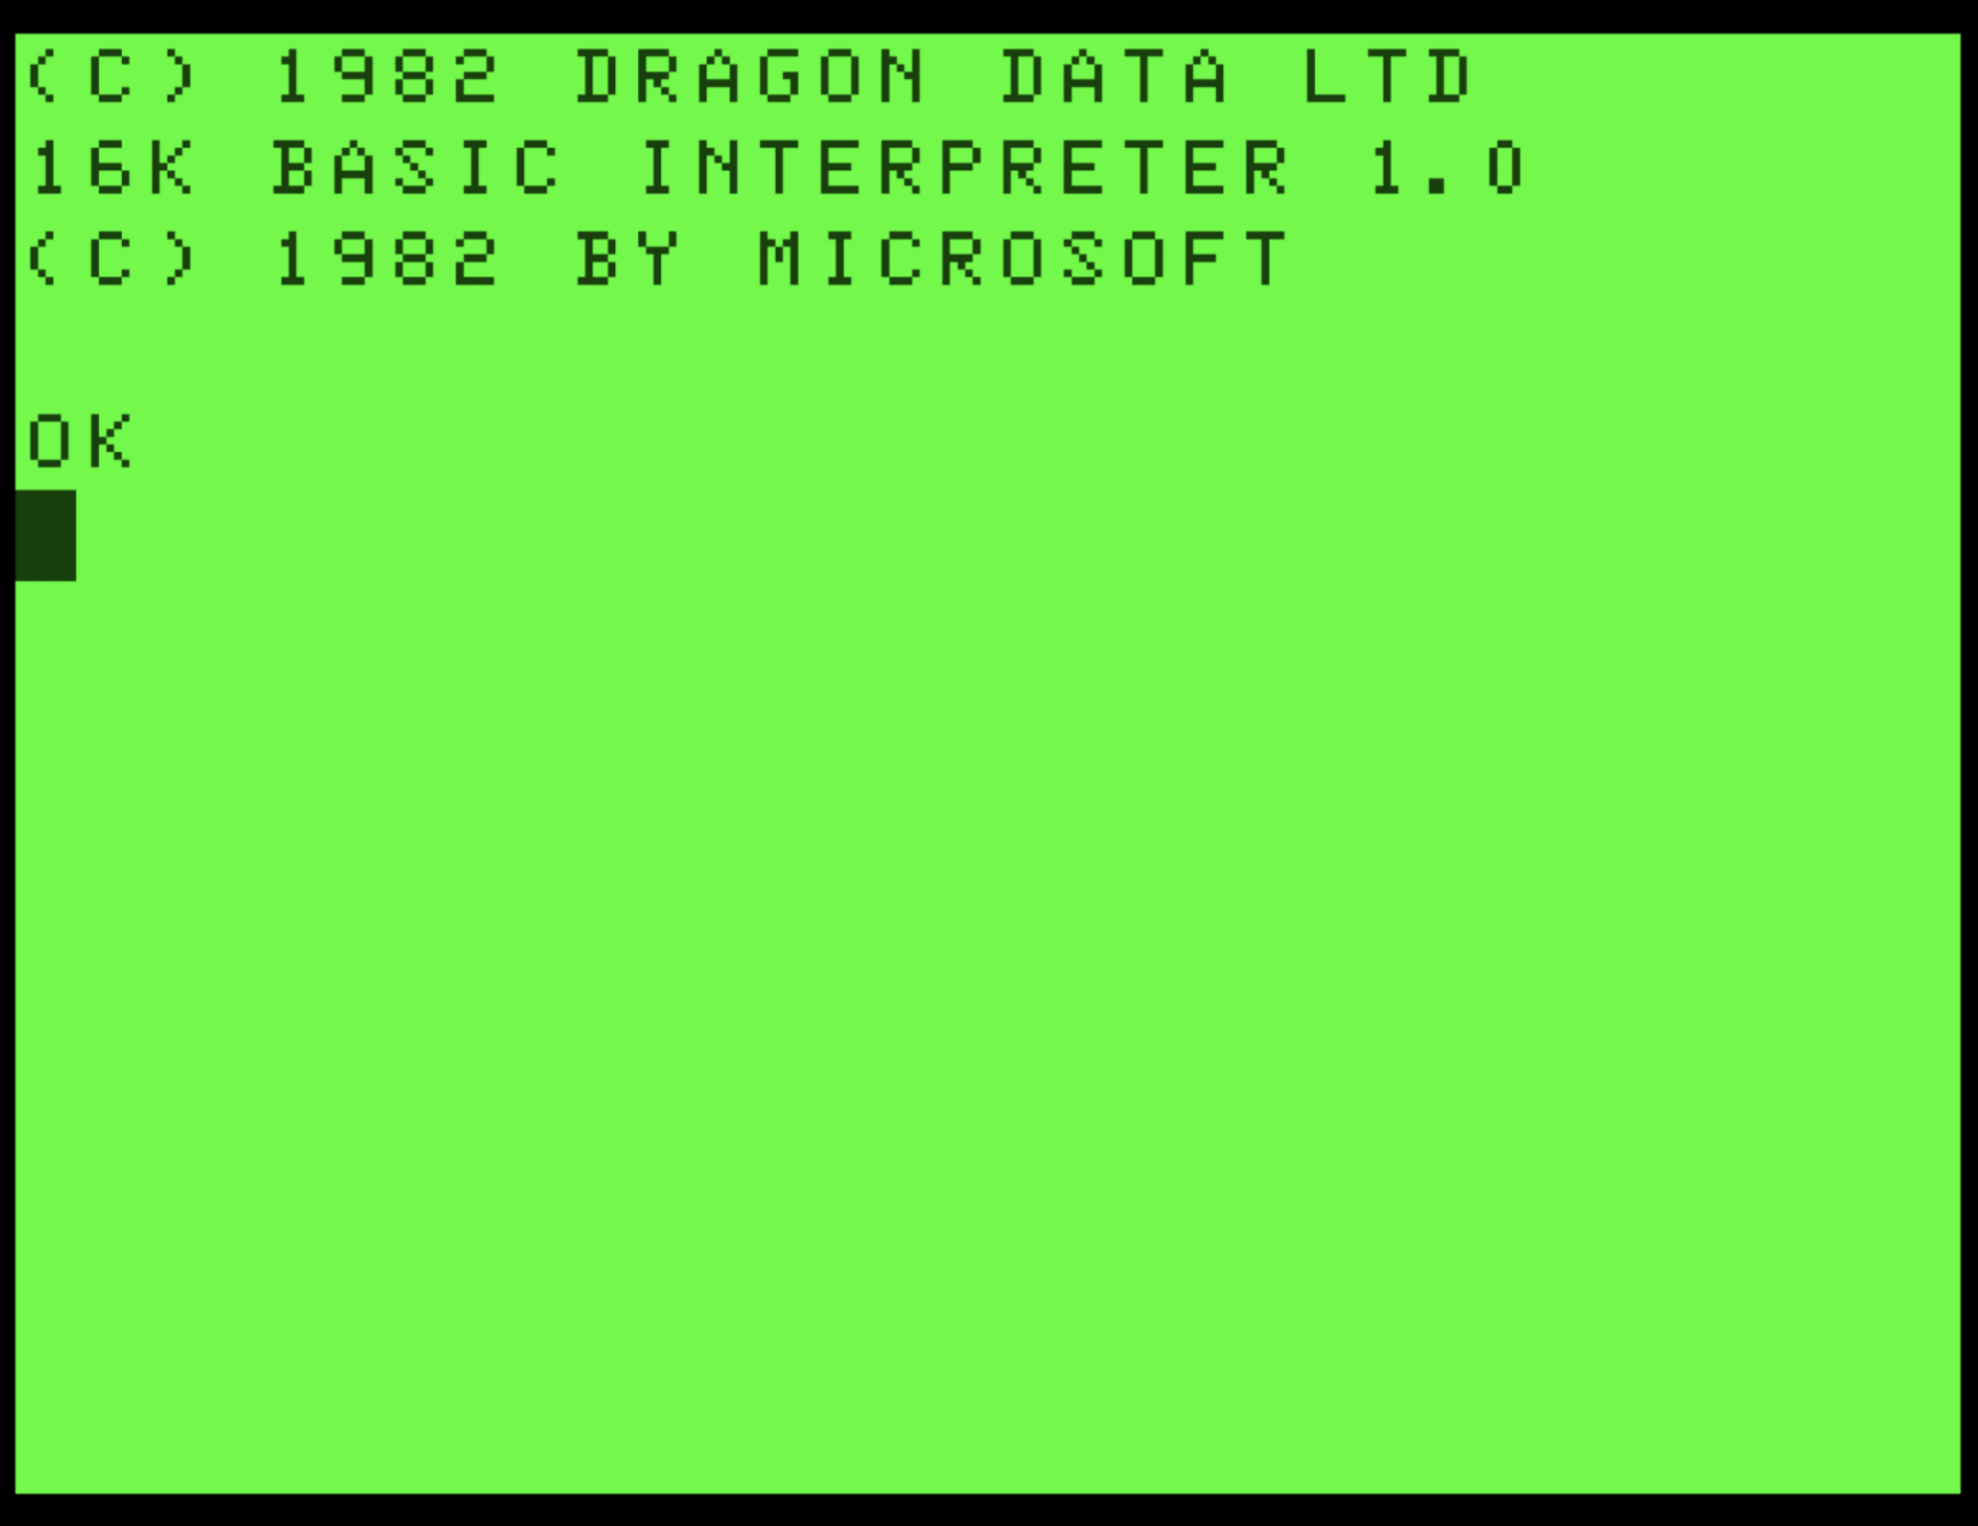
Introductions …
Background:
Programming, especially declarative: functional (1993), logic programming (1994-97)
Formal methods (1998-1999)
Engineering autonomous systems (1999-)
Interests: software engineering (process, notations, languages, …), explanation, assurance, trust, logic & formal methods
Non-work interests: my family, reading, music (choir, piano, composing)

Slide 3
Agenda: briefly cover four papers …
Partnering with AI: the case of digital productivity assistants (JRSNZ, 2023)
Artificial Intelligence and the Right to Explanation as a Human Right. (IEEE Internet Computing, 2021)
A Scoresheet for Explainable AI (AAMAS, 2025)
Evaluating Contrastive Explanations of Autonomous Systems. (under review)
Over-arching narrative: role of AI as partner, need for explanation, and how to specify and assess explanation.

Slide 4
Partnering with AI: the case of digital productivity assistants
JRSNZ, 2023, joint work with Jocelyn Cranefield, Yi-Te Chiu, Yevgeniya Li, Cathal Doyle & Alex Richter
doi: 10.1080/03036758.2022.2114507
Journal of the Royal Society of New Zealand, 53:1, 95-118
Also: Michael Winikoff, Jocelyn Cranefield, Jane Li, Alexander Richter, and Cathal Doyle. The Advent of Digital Productivity Assistants: The Case of Microsoft MyAnalytics, HICSS 2021.

Slide 5
Aim: Understand human-AI relationship in practice
Context: productivity and well-being at work: Digital Productivity Assistant (DPA)
Research Questions:
What opportunities do DPA’s offer to improve productivity & wellbeing?
What barriers are experienced?

Slide 6
Digital Productivity Assistant (DPA)
Use personal workplace data to provide insight and persuasion to help workers improve their productivity and wellbeing.
Example: Microsoft MyAnalytics (MMA) (since renamed Viva Insights)
Data: email, chats, calendar details, activity, etc.
Provide overview of behavior, and actionable advice (“AI-powered suggestions”)
Persuasion: e.g. rhetorical questions (“do you have enough uninterrupted time …”), normative suggestions (report on how any meeting invites sent less than 24 hours before meeting)

Slide 7
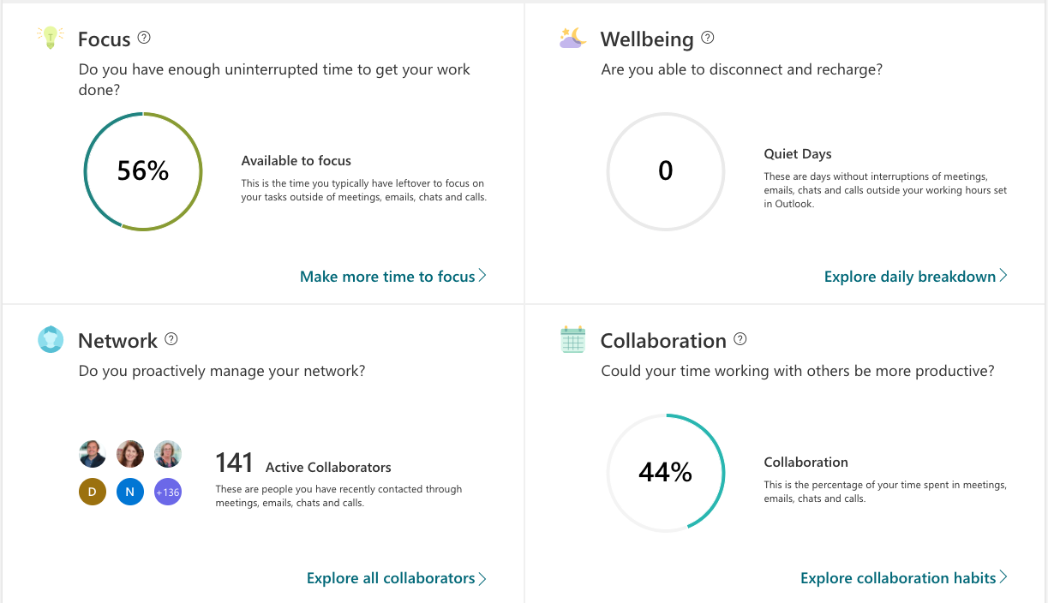

Slide 8
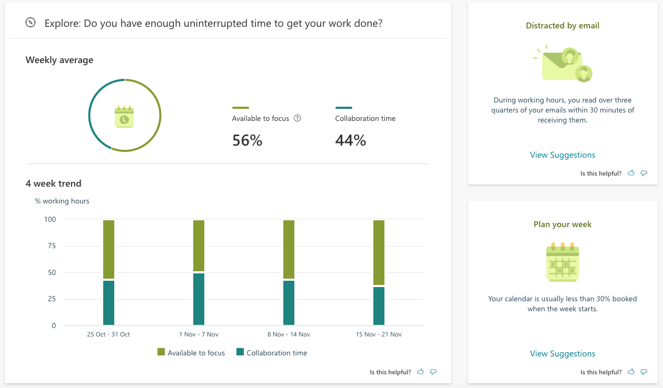
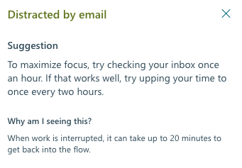

Slide 9
Methodology
Data set 2: in-depth interviews with 28 workers in 3 organisations (12 academics, 4 academic support, 12 IT professionals)
Explore general approach to self-regulation of time at work
Explore their understanding of Microsoft MyAnalytics and its value
Asking for comment on the most recent report from MyAnalytics
Data analysed iteratively, inductively to develop themes
Also (first) reviewed own use of MyAnalytics to build understanding of its functionality and user interaction

Slide 10
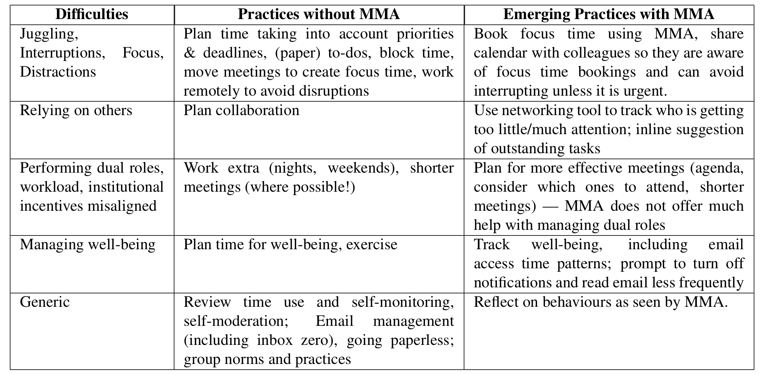
RQ1: What opportunities do DPA’s offer to improve productivity & wellbeing?
Most participants did not make use of DPA affordances, but a few did

Slide 11
RQ2: What barriers are experienced?
Perceived inaccuracy of the tool
e.g. tool cannot see ad hoc meetings
e.g. tool assumes meeting with no participants = focus time (but lecture?), and meeting with participants is collaboration (but writing group?) … also ignores non-meeting collaboration e.g. async
Lack of relevance of categories
e.g. focus/meeting – vs. teaching/research/service
e.g. focus time/collaboration duality not exhaustive
Tool creates work
e.g. new role demand to interact with tool, learning curve
e.g. change use of calendar to give tool more accurate data
But privacy & ethics not seen as issues

Slide 12
Lessons
Perceived accuracy is important
Transparency …
Concepts, e.g. “quiet days”, “focus time”
Processing, e.g. “why is this 68%?”
Assumptions, e.g. appointment with no invitees = focus time
(implicit) norms & values, e.g. meetings should be reduced
Norm conflict: reduce meetings, reduce emails
Co-regulation lens: missing feedback loop – unidirectional!
Including configurability (specific classification, categories)

Slide 13
Discussion & Conclusion
Digital Productivity Assistant – emerging class of intelligent tools
DPAs can help knowledge workers change habits and manage their time and well-being …
… but there are barriers for the use of DPAs
Key feedback loop missing (user to tool)
Transparency important!
We provide strategies to overcome the barriers (see paper)

Slide 14
Artificial Intelligence and the Right to Explanation as a Human Right
IEEE Internet Computing, 2021, joint work with Julija Sardelić (*)
doi:10.1109/MIC.2020.3045821
IEEE Internet Computing, 25(2):108-112.
* Michael Sardelic Winikoff & Julija Sardelić Winikoff

Slide 15
Key Questions:
Suppose we develop good XAI techniques …
How can we encourage organisations to use them?
… without having to create new laws

Slide 16
Key Questions:
Suppose we develop good XAI techniques …
How can we encourage organisations to use them?
… without having to create new laws
in what situations can the right to explanation be positioned as a human right?

Slide 17
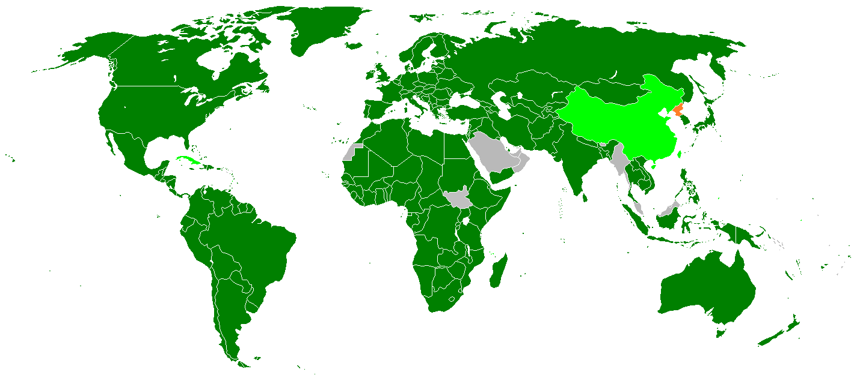
Human Rights Legislation
https://www.un.org/en/about-us/universal-declaration-of-human-rights
Universal Declaration on Human Rights (UDHR) – aspirational, not legally binding, but …
International Covenant on Civil and Political Rights (ICCPR) and International Covenant on Economic, Social and Cultural Rights (ICESCR) are legally binding on states that have ratified (dark green)
GDPR? Debatable - “an explanation of the decision” appears in the non-binding recital. Binding clauses (13-15) have “meaningful information about the logic involved”, not an explanation of a specific decision made.
ICCPR status
https://commons.wikimedia.org/wiki/File:ICCPR-members2.PNG

Slide 18
XAI and Human Rights: Discrimination
“the right to social security” (UDHR article 22)
“the right to a standard of living … and well-being … including food, clothing, housing and medical care and necessary social services” (Article 25)
“higher education shall be equally accessible to all on the basis of merit” (Article 26)
Cannot use prohibited criteria “such as race, colour, sex, language, religion, political or other opinion, national or social origin, property, birth or other status” (Article 2) … or proxies for these!
Explanation can help detect (and avoid) such use

Slide 19
XAI and Human Rights: Judicial applications
Legal rights prominent in human rights documents (Articles 6-11 UDHR)
Judicial system expected to be highly accountable
Consequences of legal processes can affect human rights, including: physical freedom (UHDR 3&9), privacy (12), property ownership (17), citizenship removal (15).
“arbitrary” – need explanation to assess
Also “without any discrimination” (7), and a fair hearing “by an independent and impartial tribunal” (10).
Also right “To be informed promptly and in detail in a language which he [or she] understands of the nature and cause of the charge against him [or her]” (ICCPR 13)

Slide 20
XAI and Human Rights: Other Cases
“right to freedom of opinion and expression” (19) – what about AI-curated social media?
Health

Slide 21
Summary
Q: How can we motivate organisations to deploy explanation mechanisms?
A: Range of cases in which the right to explanation can be argued to be a natural consequence of existing human rights obligations

Slide 22
A Scoresheet for Explainable AI
AAMAS, 2025, joint work with John Thangarajah and Sebastian Rodriguez
arXiv:2502.09861v1
In Proc. of the 24th International Conference on Autonomous Agents and Multiagent Systems (AAMAS 2025), Detroit, IFAAMAS, 10 pages. Also available (with supplementary material) from arXiv:2502.09861v1.

Slide 23
Why?
Explainability important for e.g. transparency, accountability, understandability, trust calibration
Given a choice of systems, how to compare explainability?
Existing work (e.g. ALTAI*, IEEE P7001) does not provide adequate guidance for assessing explainability
* Assessment List for Trustworthy Artificial Intelligence

Slide 24
What?
A scoresheet for Explainable AI
Can be used to assess systems
… or to specify explainability requirements

Slide 25
Contributions
A scoresheet for Explainable AI (next slide)
… with justification,
… guidance for how to complete it (including a checklist for global explanations), and
… demonstration on a range of systems
usable, generic, useful

Slide 26
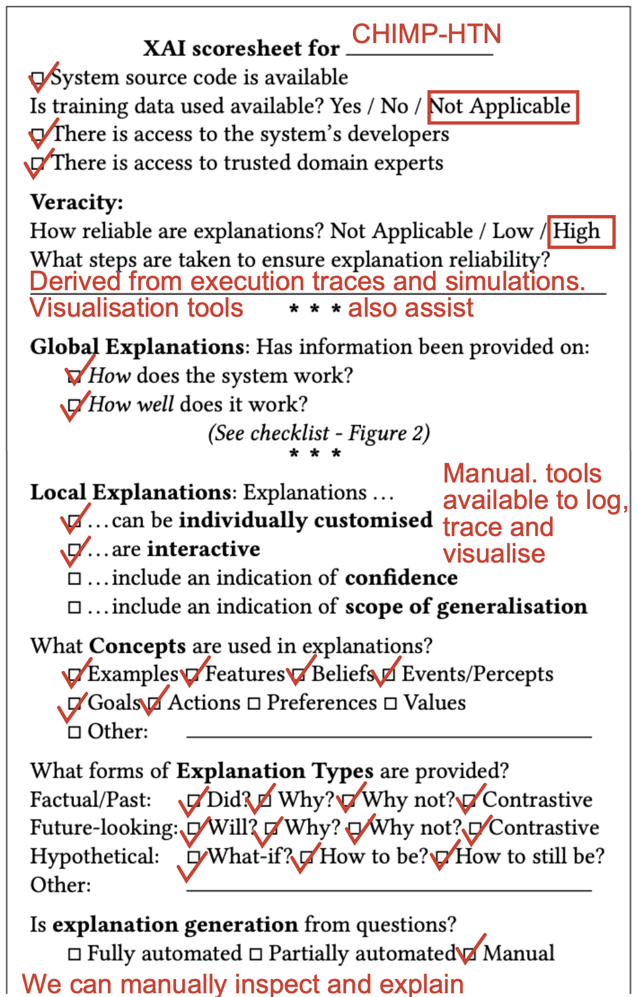
Scoresheet covers …
Basic information
Veracity
Global Explanations: how, how well?
Local Explanations
Features (e.g. customization, interaction)
Concepts used
Explanation Types
Automation

Slide 27
Scoresheet covers …
Basic information
Veracity
Global Explanations: how, how well?
Local Explanations
Features (e.g. customization, interaction)
Concepts used
Explanation Types
Automation

Slide 29
Evaluating Contrastive Explanations of Autonomous Systems
(under review)

Slide 30
Contrastive Explanations
Explanation: “Why did you do X?”
Contrastive: “Why did you do X instead of Y?”
Terminology: X is the fact, Y is the foil?
Evidence that humans ask contrastive questions
… but sometimes implicitly (i.e. foil is implicit)

Slide 31
Human-subject evaluation
Have previously shown that contrastive explanations are shorter (see paper)
But are they preferred (by humans) and are they effective (at supporting appropriate trust and transparency)?

Slide 32
We hypothesise that …
H1 contrastive explanations are preferred to full explanations.
H2: the perceived quality of explanation is higher for contrastive than for full explanations.
H3: contrastive explanations are more likely to be considered to have the right level of detail.
H4: contrastive explanations yield higher trust than full explanations.
H5: contrastive explanations yield higher belief in understanding of the system than full explanations.
H6: contrastive explanations yield more confidence in the system's correct behaviour than full explanations.
H7: both types of explanation yield higher trust than no explanation.
H8: having an explanation (either full or contrastive) yields more confidence in the system’s correct behaviour than not having an explanation.
H9: there is a correlation between trust in technology in general and trust in each of the two systems, but that the strength of the correlation is not high.
preference
Expl. type
effectiveness
No expl.

Slide 33
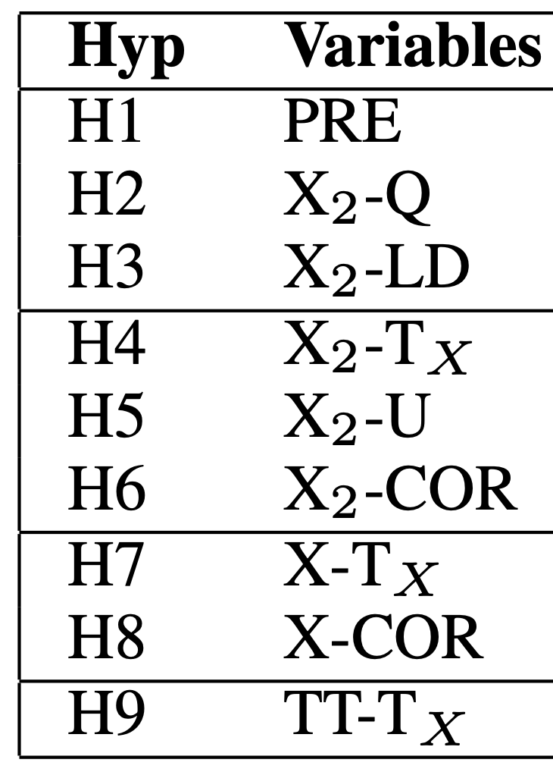
Methodology
Used Prolific to recruit gender-balanced sample of adults fluent in English
Split into three groups (X): full, contrastive, none
Survey: (sections repeated: 2 systems, 3 scenarios each)
Technology Trust (TT),
Present System (pancake robot and search-and-rescue)
Present Scenario (including action and explanation [except for None group])
Explanation quality (Q), understanding (U) and level of detail (LD) [skip for None]
Trust (short) and belief in correctness (COR) [for each scenario]
Trust (long) [for each system] T_{Pan} and T_{SAR}
Preferred explanation (PRE) for six scenarios
Demographics
X₂ – full & contrastive only

Slide 34
Responses
161 responses
Filtered using attention check questions (12 responses failed both, 18 failed one)
Filtered using inconsistent short-long trust responses (27 responses)
104 responses analysed
Also checked quick completions
Cronbach’s alpha checked, high enough (>0.8)

Slide 35
Explanation Type Preferences
H1 contrastive explanations are preferred to full explanations
Partially confirmed: scenarios 1-4 show difference, 1&2 prefer contrastive, 3&4 prefer full explanations
H2: the perceived quality of explanation is higher for contrastive than for full explanations.
Not confirmed: no significant difference
H3: contrastive explanations are more likely to be considered to have the right level of detail.
Not confirmed: no significant difference

Slide 36
Explanation Type Effectiveness
H4: contrastive explanations yield higher trust than full explanations.
Confirmed: median trust for contrastive 3.5 (pancake) & 3.67 (SAR) vs. full explanation 3.0 (pancake) & 3.17 (SAR)
H5: contrastive explanations yield higher belief in understanding of the system than full explanations.
Confirmed, but only for scenario 2 (mean 3.676 vs. 4.225 for contrastive)
H6: contrastive explanations yield more confidence in the system's correct behaviour than full explanations.
Confirmed, but only for scenarios 1&2

Slide 37
Effects of not having explanations
H7: both types of explanation yield higher trust than no explanation.
Not confirmed: no significant difference (however, median was higher for no explanation!)
H8: having an explanation (either full or contrastive) yields more confidence in the system's correct behaviour than not having an explanation.
Not confirmed: significant difference for scenarios 3&4 with lower score for full than no explanation

Slide 38
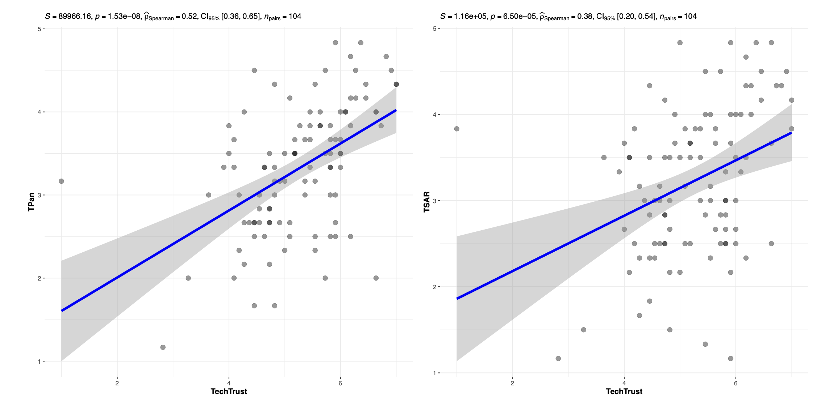
Trust vs. Trust in Technology
H9: there is a correlation between trust in technology in general and trust in each of the two systems, but that the strength of the correlation is not high.
Confirmed: highly significant (p<<0.01) but moderate strength ⍴=0.52 (pancake) & 0.38 (SAR)

Slide 39
Discussion
Y. Amitai, Y. Septon, and O. Amir. Explaining reinforcement learning agents through counterfactual action outcomes. AAAI, 2024. doi:10.1609/AAAI.V38I9.28863
M. Harbers. Explaining Agent Behavior in Virtual Training. SIKS dissertation series no. 2011-35, SIKS (Dutch Research School for Information and Knowledge Systems), 2011.
Harbers, K. van den Bosch, and J. C. Meyer. Design and evaluation of explainable BDI agents. IAT, 2010. doi:10.1109/WI-IAT.2010.115
F. Kaptein, J. Broekens, K. V. Hindriks, and M. A. Neerincx. Personalised self-explanation by robots: The role of goals versus beliefs in robot-action explanation for children and adults. Ro-MAN, 2017. doi:10.1109/ROMAN.2017.
F. Kaptein, J. Broekens, K. V. Hindriks, and M. A. Neerincx. Evaluating cognitive and affective intelligent agent explanations in a long-term health-support application for children with type 1 diabetes. ACII, 2019. doi:10.1109/ACII.2019.8925526.
Difference between preference and effectiveness (cf. Amitai et al): contrastive not consistently preferred, but did give higher trust
For some scenarios providing full explanations reduced trust (compared with no explanation). Kaptein et al also found counter-intuitive results (recommendation explanations resulted in participants being less likely to follow them)
Human decision-making is complex! Speculation: too-long explanations might reduce system trust?
Scenario dependent results consistent with prior work (Harbers et al)
Possible issue with foil mismatch …

Slide 40
Implications
Important to ensure foil matches user’s expectations – ask user
Providing explanations is not risk-free – poor quality or too-long explanations can reduce trust
Human behaviour is complex. Need to iteratively guide development & deployment with (careful) user evaluation

Slide 41
Future Work
Making explanations interactive
Adding hypothetical explanations (What if? How to be? How to still be?)
Extending to non-BDI agents (cf. Gimenez-Abalos et al policy graph work for “Why?”)
Further evaluation (more scenarios, systems)
One approach for handling foil mismatch: ask what system should do and then use that as the foil … but low trust …

Slide 42
Summary
AI tools sometimes need to be viewed as partners
Explanation is important for transparency and trust
Explanation can be arguably motivated under existing laws
A scoresheet can be used to succinctly describe the explanatory capabilities of a system
Providing effective explanations can be tricky

Slide 43


Slide 44
https://youtu.be/ESNDtH6suUo
https://youtu.be/mxhcQgvBD2Y

Slide 45
Demographics
Gender: 50 Male, 54 Female.
Age: 23 participants were aged 18-24, 49 were aged 25-34, 15 (35-44), 10 (45-54), 5 (55-64), 2 (65-74), 0 (75+).
Education: 22 (completed high school), 56 (completed undergrad degree), 23 (Masters), 2 (PhD), 1 (declined to answer).
Ethnicity: 40 (African), 36 (European), 8 (North American), 7 (South American), 5 (Asian), 3 (Other), 2 (Australian), 2 (declined), 1 (New Zealander).
Programming experience: 38 (None), 28 (hobby), 12 (studied at high school), 12 (currently studying degree), 10 (completed degree), 4 (other).

Slide 46
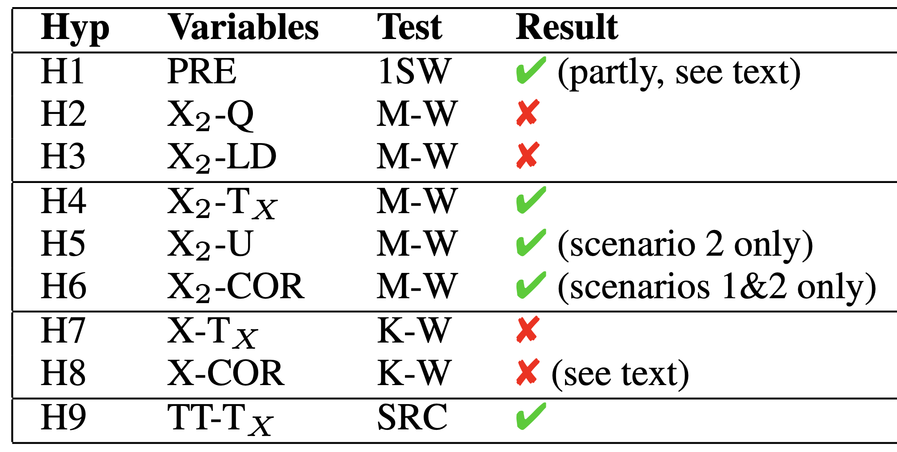
Summary of Results

